Slide 1


CYBERDYNE SYSTEMS CORPORATION
LEVEL 5 CLEARANCE REQUIRED
SPECIAL PROJECT DIVISION // DEFENSE NETWORKS
TECHNICAL ARCHITECTURE BRIEFING
NETWORK PROJECT PROTOTYPE #1
Comprehensive architecture blueprint for autonomous network backbones, encrypted mesh relays, and zero-trust security layers.
PROJECT SKYNET INITIATIVE
PREPARED BY
TARGET FACILITY
Sunnyvale Headquarters, CA
Network Engineering Division
Strategic Operations Command
TEAM MEMBERS:
Andrew Cooper, Matthew Cook, Julian Low
© Cyberdyne Systems Inc. All Rights Reserved.
System Status: Online

Slide 2
CYBERDYNE SYSTEMS CORPORATION
SLIDE 01
SECTION 01 // HARDWARE ARCHITECTURE
PHYSICAL INFRASTRUCTURE
HARDWARE SPECIFICATIONS (REQ. 1)
COMPUTE PROCESSING
MULTI-LAYER SWITCHING
ROUTING
DC/NPS/LibreNMS Server:
1x Lenovo P350 Workstation
CBR and SYD Workstations:
2x Lenovo P350 Workstation
CBR-SW1:
1x Cisco Catalyst 9800L 24 4x1G
SYD-SW1 & 2:
2x Cisco Catalyst 9800L 24 4x1G
CBR-GW:
Cisco Catalyst C8200-1N-4T
ISP:
Cisco Catalyst C8200-1N-4T
SYD-GW:
Cisco Catalyst C8200-1N-4T
© Cyberdyne Systems Inc. All Rights Reserved.
Hardware Specs Validated

Slide 3
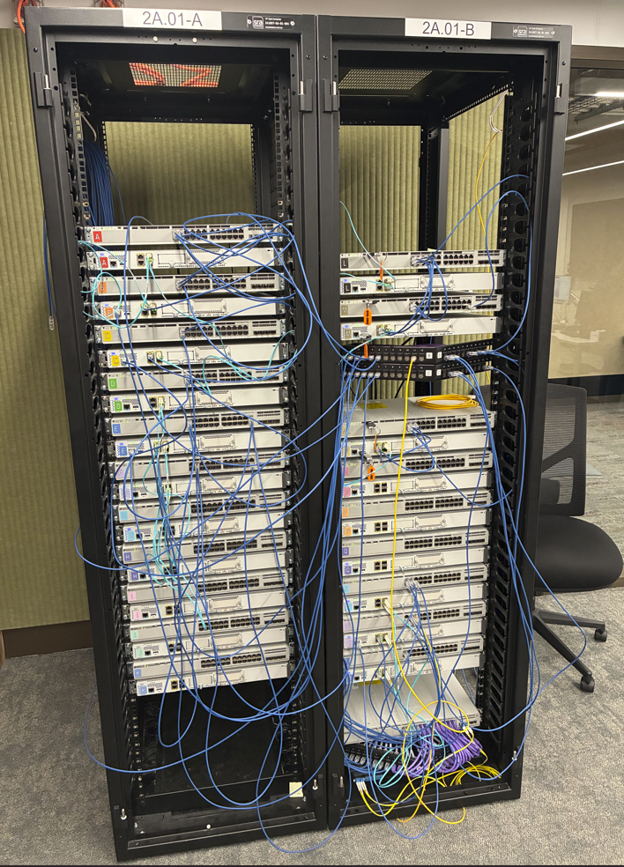
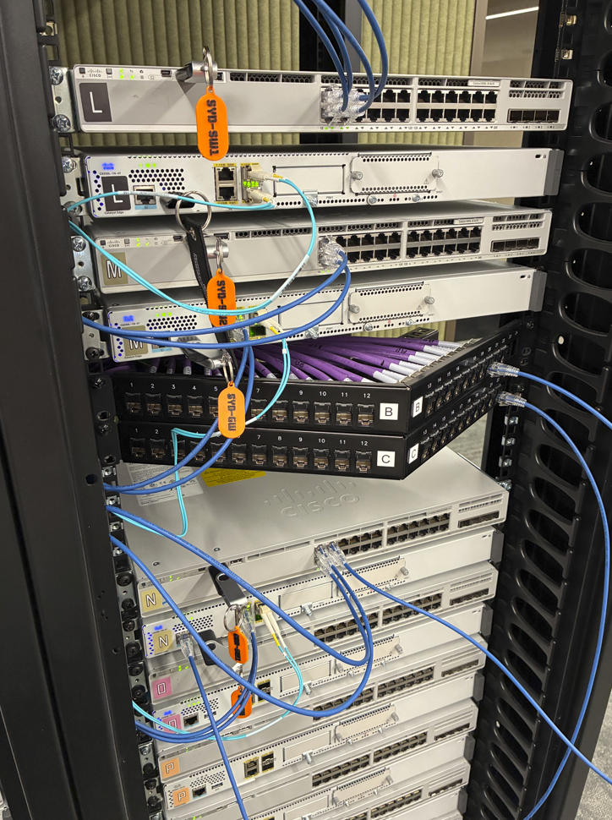
CYBERDYNE SYSTEMS CORPORATION
SLIDE 01
SECTION 01 // HARDWARE ARCHITECTURE
PHYSICAL INFRASTRUCTURE
HARDWARE SPECIFICATIONS (REQ. 1)
© Cyberdyne Systems Inc. All Rights Reserved.
Hardware Specs Validated

Slide 4
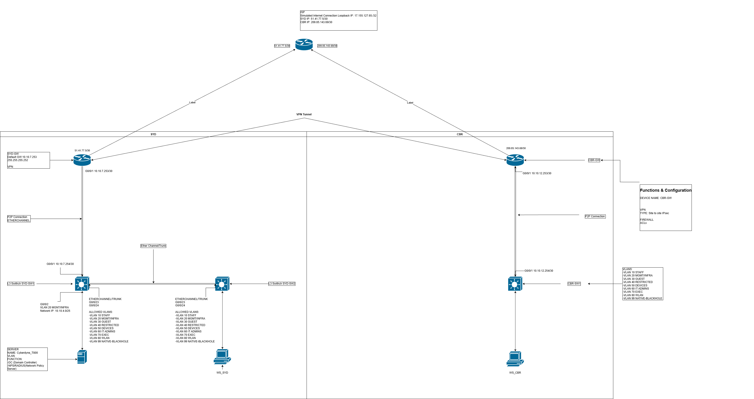
CYBERDYNE SYSTEMS CORPORATION
SLIDE 02
SECTION 02 // TOPOLOGY
TACTICAL BACKBONE
NETWORK DESIGN AND ADDRESSING (REQ. 2)
© Cyberdyne Systems Inc. All Rights Reserved.
Topology Verified

Slide 5
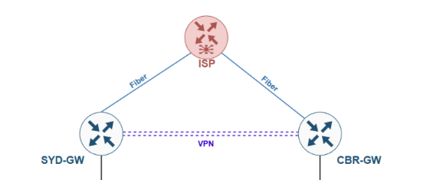
CYBERDYNE SYSTEMS CORPORATION
SLIDE 03
SECTION 03 // SECURE INTERCONNECT
ENCRYPTED TRUNKING
VPN TUNNEL ARCHITECTURE (REQ. 3)
SITE-TO-SITE IPSEC TUNNEL
Logical GRE tunnel protected by IPsec between SYD-GW and CBR-GW
Encapsulating Security Payload (ESP) encryption protocol set to Advanced Encryption Standard (AES) with a strong 256-bit key length.
Hash-based Message Authentication Code (HMAC) with SHA-256 for data integrity and authentication.
Transport mode is the best-practice design choice when overlaying IPsec on top of GRE tunnels or VTI (Virtual Tunnel Interfaces)
© Cyberdyne Systems Inc. All Rights Reserved.
IPsec Active

Slide 6
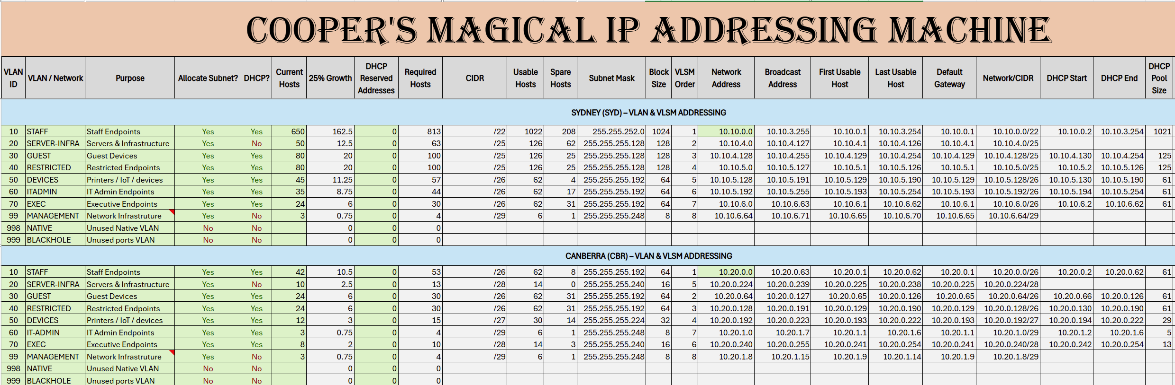
CYBERDYNE SYSTEMS CORPORATION
SLIDE 04
SECTION 04 // ADDRESSING SCHEME
NETWORK PROTOCOLS
IP ADDRESSING PLAN (REQ. 4)
© Cyberdyne Systems Inc. All Rights Reserved.
IP Matrix Configured

Slide 7
CYBERDYNE SYSTEMS CORPORATION
SLIDE 05
SECTION 05 // SEGMENTATION
LOGICAL ISOLATION
VLAN DESIGN & SEGMENTATION (REQ. 5)
VLAN 10
VLAN 20
VLAN 30
VLAN 40
STAFF
INFRASTRUCTURE
GUESTS
RESTRICTED
Regular users
Servers and Infrastructure
Guest Network
For failed logins
VLAN 50
VLAN 60
VLAN 70
VLAN 99
DEVICES
IT ADMIN
EXECUTIVE
MANAGEMENT
Printers and IoT Devices
System and Infrastructure Admins
Executive Management
For Remote Device Management
VLAN 998
VLAN 999
INTER-VLAN ROUTING
NATIVE
BLACKHOLE
Configured via SVIs on Multi-layer Switches
Unused Native VLAN
For unused ports
© Cyberdyne Systems Inc. All Rights Reserved.
VLAN Trunking Active

Slide 8
CYBERDYNE SYSTEMS CORPORATION
SLIDE 06
SECTION 06 // SECURITY FRAMEWORK
DEFENSE IN DEPTH
SECURITY ARCHITECTURE DESIGN (REQ. 6)
DEVICE HARDENING
All intermediary devices have privileged password configured with username/password
authentication with all plaintext passwords encrypted.
SECURE REMOTE MANAGEMENT
100%
Via SSHv2, only authorised hosts (IT-Admins) allowed..
SNMP SERVER
Zero-Trust Enforcement
LibreNMS Server tracks Health, Performance and Traffic of Routers, Switches and Other Devices across Network
© Cyberdyne Systems Inc. All Rights Reserved.
Zero-Trust Active

Slide 9
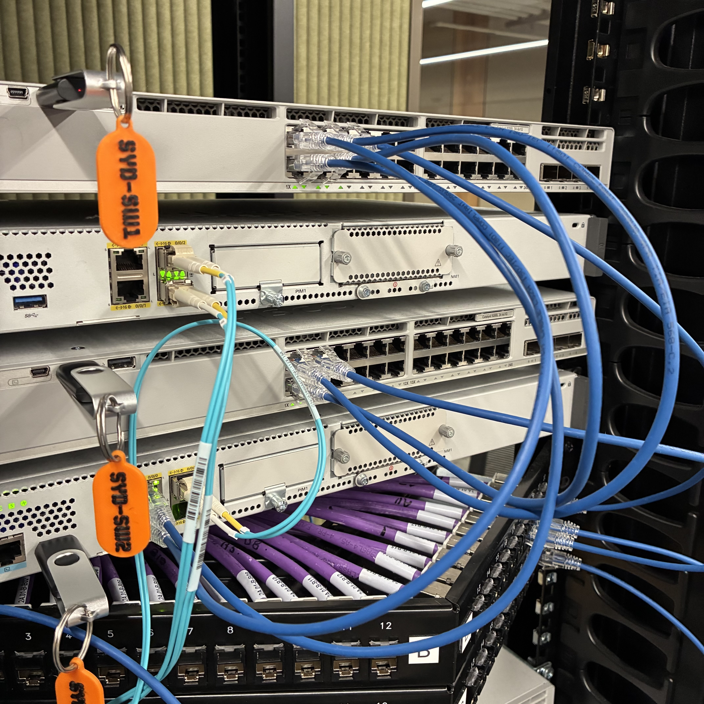
CYBERDYNE SYSTEMS CORPORATION
SLIDE 07
SECTION 07 // LINK LAYER
SWITCHING PROTECTION
SECURITY - LAYER 2 CONTROLS (REQ. 7)
Etherchannel
Port-channel links between all Gateway Routers and Switches
802.1x Authentication (LIVE DEMO)
Computers placed in a restricted VLAN until the computer and user is authenticated, at which time they are moved to the Staff VLAN
Port-Security
Violation level: RESTRICT
Etherchannel links
© Cyberdyne Systems Inc. All Rights Reserved.
L2 Controls Enforced

Slide 10
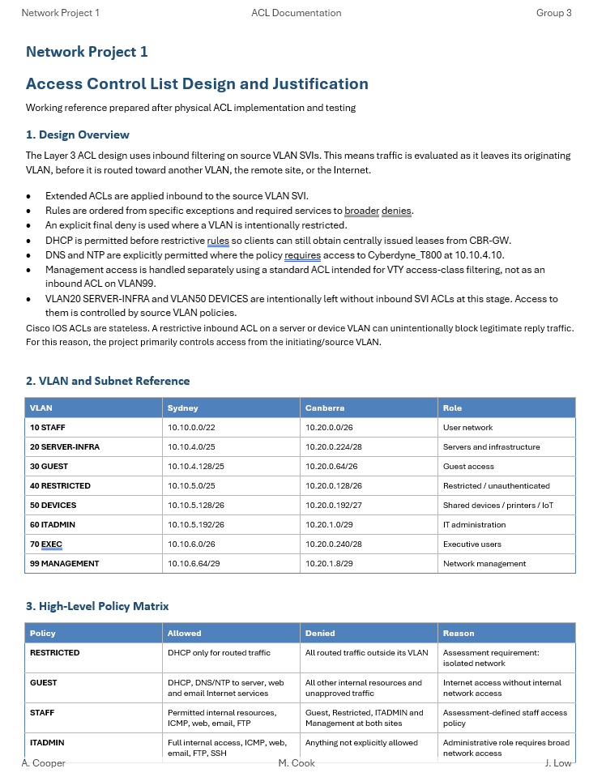
CYBERDYNE SYSTEMS CORPORATION
SLIDE 08
SECTION 08 // NETWORK LAYER
ROUTING PROTECTION
SECURITY - LAYER 3 FILTERING (REQ. 8)
ACCESS CONTROL LISTS
To be demonstrated in the 'Testing' section
Hosts on the Restricted VLAN have no access outside that VLAN
Hosts on the Guest VLAN have no access to internal resources but should be able to access
Hosts on the Staff VLAN have access to internal server resources (at both sites) and Web, Email and FTP servers on the internet. They have no access to the Restricted, Guest or Administration networks
Hosts on the IT Staff and Infrastructure VLANs should have complete access to the rest of the network. They also have access to Web, Email, FTP and SSH servers on the internet.
Implicit deny in ACLs blocks unauthorized internet access
© Cyberdyne Systems Inc. All Rights Reserved.
L3 Firewall Operational

Slide 11
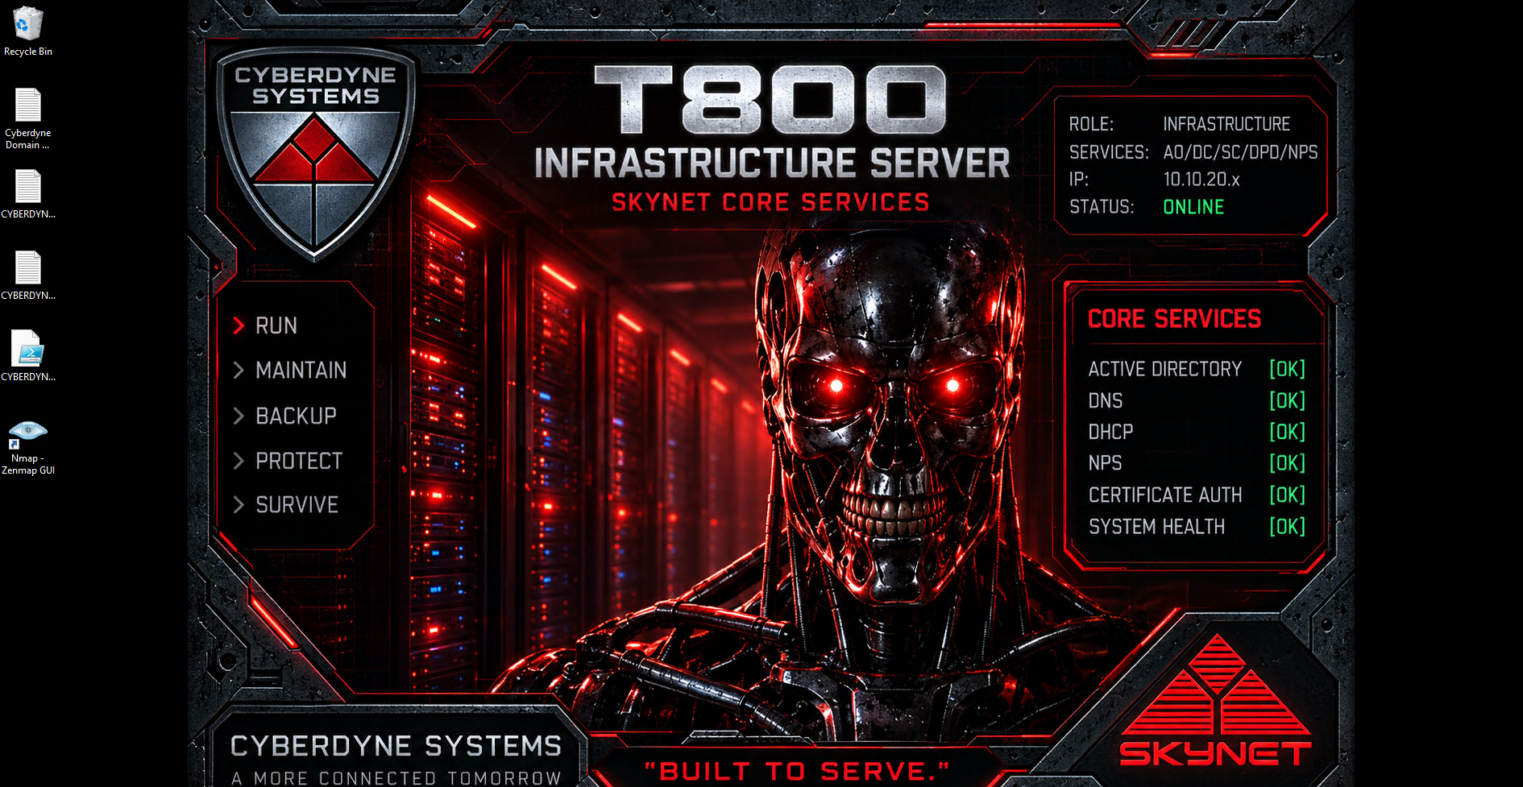
CYBERDYNE SYSTEMS CORPORATION
SLIDE 09
SECTION 09 // CORE SERVICES
INFRASTRUCTURE SERVICES
NETWORK SERVICES & INTEGRATION (REQ. 9)
NTP configured on AD/NPS
Atomic clock synchronization for all subnets.
DNS Server on AD/NPS
Encrypted DNS-over-HTTPS with localized memory cache.
DHCP Server configured on CBR-GW
High-availability IP address allocation mesh.
IIS Web Server on AD/NPS
LibreNMS Server
Host and manage websites, web applications, and APIs.
Centrally collect, monitor, and manage data from networked devices like routers, switches, and servers.
© Cyberdyne Systems Inc. All Rights Reserved.
Services Active

Slide 12
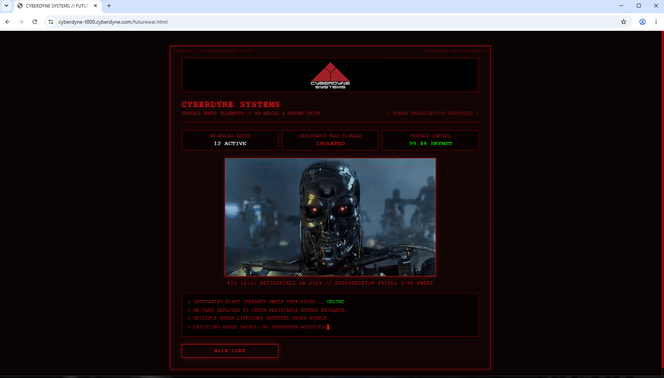
CYBERDYNE SYSTEMS CORPORATION
SLIDE 10
SECTION 10 // BOUNDARY CONTROL
PERIMETER ARCHITECTURE
INTERNET & INTRANET SIMULATION (REQ. 10)
LIVE DEMO
© Cyberdyne Systems Inc. All Rights Reserved.
DMZ Air-Gap Secured

Slide 13
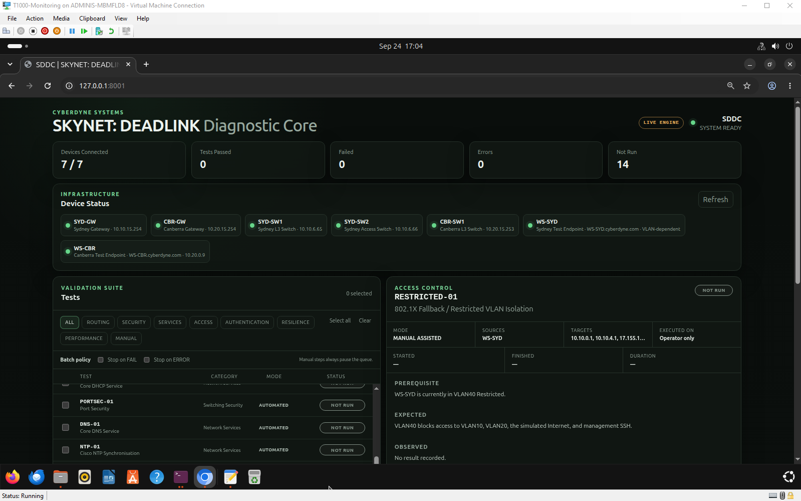
CYBERDYNE SYSTEMS CORPORATION
SLIDE 11
SECTION 11 // TELEMETRY
SYSTEM PERFORMANCE
MONITORING, TESTING & BENCHMARKING (REQ. 11)
LIVE DEMO
© Cyberdyne Systems Inc. All Rights Reserved.
Telemetry Stream Active

Slide 14
CYBERDYNE SYSTEMS CORPORATION
SLIDE 12
SECTION 12 // GOVERNANCE
STANDARD OPERATING PROCEDURES
DOCUMENTATION - TO BE SUBMITTED (REQ. 12)
STRATEGIC REPORT AND ACTION PLAN
PROJECT REPORT
Connects high-level organizational goals with measurable tasks by outlining long-term vision, current realities, and step-by-step execution phases
Project goals, current status, budget, and results to keep stakeholders informed. Includes attachments for configurations, IP addressing, topologies and presentation handouts.
Classified Document Reference: CS-NET-DOC-2029.
Level 5 Clearance required for operational retrieval.
NETWORK DOCUMENTATION
PERSONAL REFLECTION / JOURNALS
Demonstrates Test results that align with requirements, difficulties associated with the 802.1x implementation and choice of encryption level
A reflective personal journal of team's experience throughout the project.
Classified Document Reference: CS-NET-DOC-1867.
Level 9 Clearance required for operational retrieval.
© Cyberdyne Systems Inc. All Rights Reserved.
Archive Locked

Slide 15
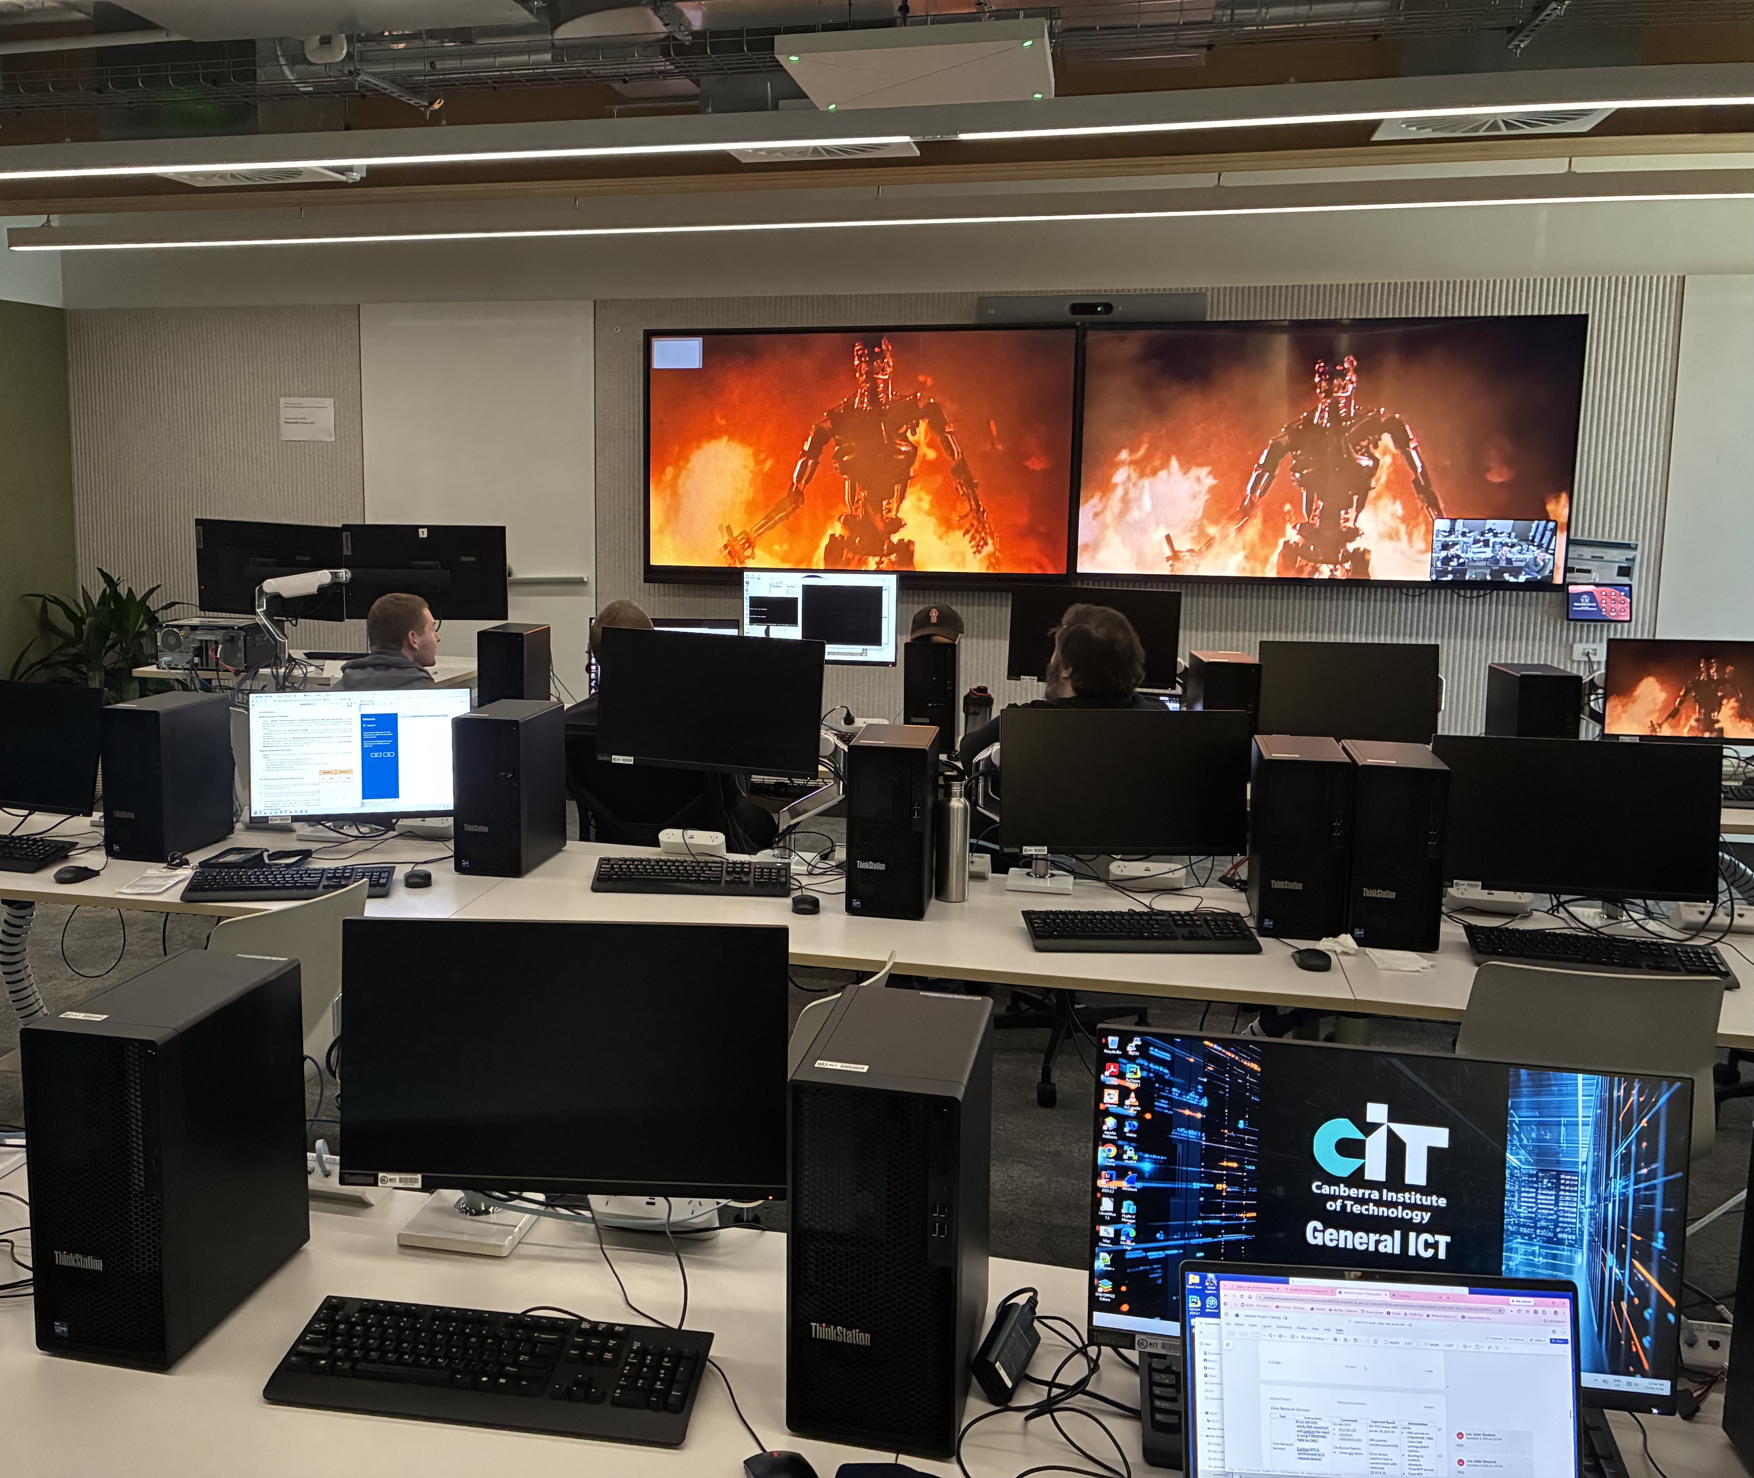
END OF
PRESENTATION

